Slide 1

MINOR PROJECT ON E-Healthcare Management system
Master in Computer Application in Artificial Intelligence
UNIVERSITY SCHOOL OF INFORMATION AND COMMUNICATION TECHNOLOGY, GAUTAM BUDDHA UNIVERSITY, GREATER NOIDA-201312, UTTAR PRADESH INDIA
JANAUARY,2024
Presented by :-
Sumit Kumar(225/PCA/014)
Ritik Chauhan(225/PCA/022)
Pankaj Kumar(225/PCA/008)
Under the Guidance of Supervision:-
Mr. Manish Kumar Singh

Slide 2
Contents:
Introduction
Existing System
Proposed System
Advantages of Proposed system
Software and hardware Requirement
Flowchart
Modules
Screenshots
Conclusion
Drawbacks of Existing system
Packages
Future Enhancement

Slide 3

INTRODUCTION:
The main objective while implementing the project E-Health care management System was to minimize the work and at the same time increase the speed of the work done.
This project deals with the Corporate Medicare Management. This project is very helpful to both Medicare staff as well as to the public.
The growing quality demand in the hospital sector makes it necessary to exploit the whole potential of stored data efficiently.

Slide 4

EXISTING SYSTEM:
Hospital currently use a manual system for the management and maintenance of critical information.
The current system requires numerous paper forms, with data stores spread throughout the hospital management infrastructure.
Often information (on forms) is incomplete, or does not follow management standards

Slide 5
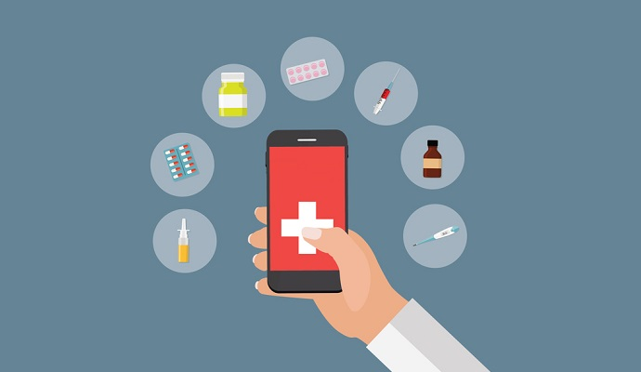
DRAWBACKS OF PRESENT SYSTEM:-
Fast report generation is not possible.
Sensitive patient data could fall into the wrong hands as the data is store in registers
Lack of communication between patient and doctor
No central database can be created as information is not available in database

Slide 6


PROPOSED SYSTEM:
The E health care management system is design for Any hospital to replace their existing manual, paper based system.
The new system controls the following information such as patient information, room availability, staff and operating room schedules, and patient invoices.
These services are to be provided in an efficient, cost effective manner, with the goal of reducing the time and resource currently required for such task.

Slide 7
It provides better and efficient service to patient.
Reduce the workload of employee.
It is User friendly.
Provide facility for proper monitoring reduces paper work and provide data security.
ADVANTAGES of Proposed system

Slide 8
Software and Hardware requirement:
Hardware requirements:
Software requirements:
Hard Disk: 40 GB
CPU: Intel core i3
or more
RAM: 2GB
or more
Processor: 2.4GHz
Programming language: JAVA
Operating system:
Windows 7 and more

Slide 9
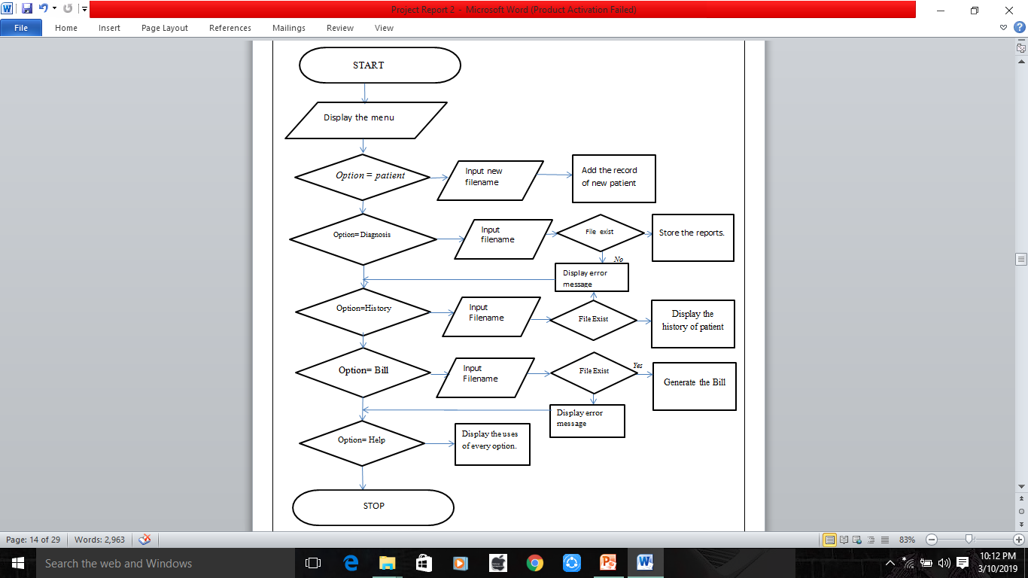
FLOWCHART:
Yes
Yes
No

Slide 10
packages :
java.util.*: This package provides the utility classes for collection framework, events, date, and time manipulation, etc.
java.lang.String: This is the core class for handling strings in Java. The String class is part of the java.lang package, so it's automatically imported, and you don't need to explicitly import it.
java.io.*:
This package provides classes for input and output operations, such as reading and writing to files.
java.time.format.DateTimeFormatter & java.time.LocalDateTime: These classes are part of the Java Date and Time API introduced in Java 8. They are used for formatting and parsing date-time objects.
DateTimeFormatter:
This class provides formatting and parsing for date-time objects. You can use it to define a pattern for formatting and parsing dates and times.
LocalDateTime:
This class represents a date-time without a time zone in the ISO-8601 calendar system. It's often used to represent a specific date and time, and you can perform various operations on it.

Slide 11
MODULES:
Patient module:-
Diagnosis module:-
Bill module:-
Adding the new record of a patient. Patient’s personal information can be store by using this module.
This module used to store or produce the laboratory reports. Patient ID, ward Category, Doctor, Date, Medicines or drugs.
It generates the bill of the patient with displaying the details such as Patient ID, doctor’s charge, room bill, medicine bill, total amount, No of days, Service charge, Nursing care, Lab bill.
Help module:-
This module gives information about the working of every module.
History module:-
This module gives all the information of the existing patient.

Slide 12
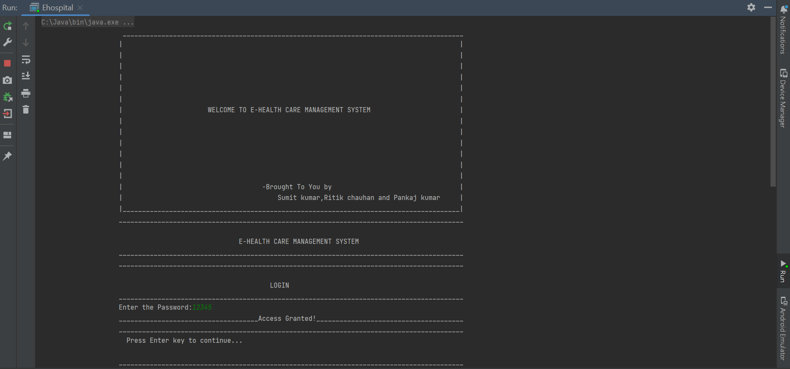
Screenshots:

Slide 13
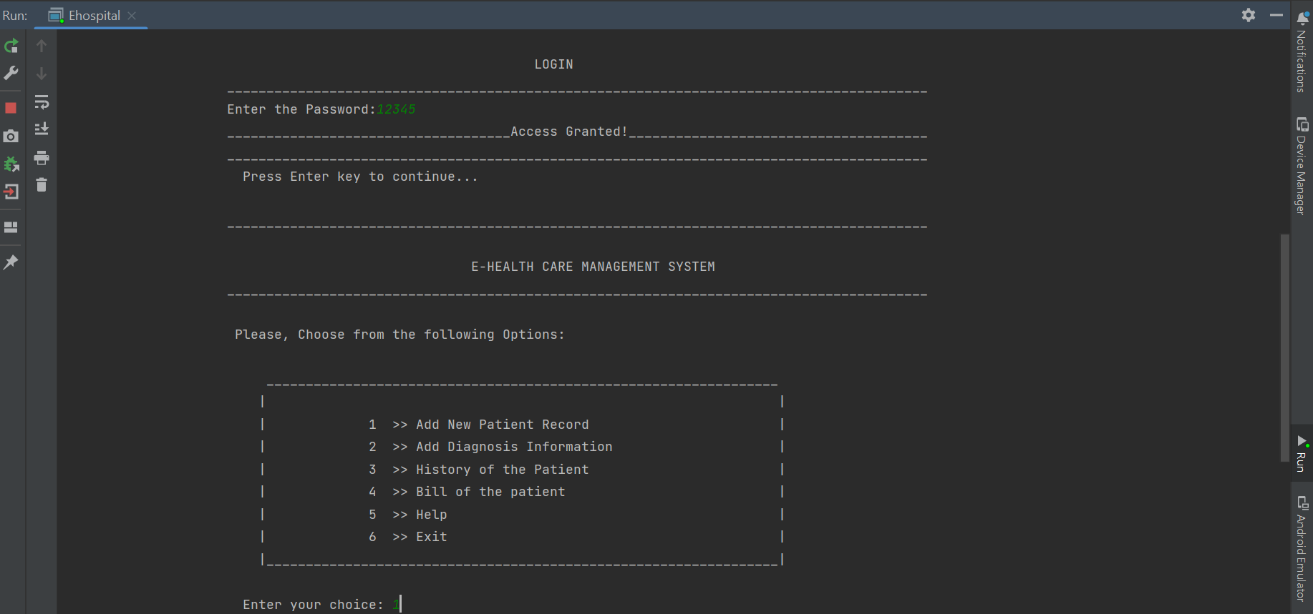

Slide 14
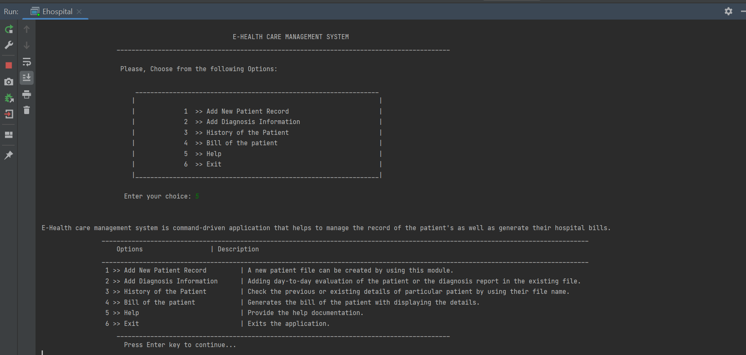

Slide 15
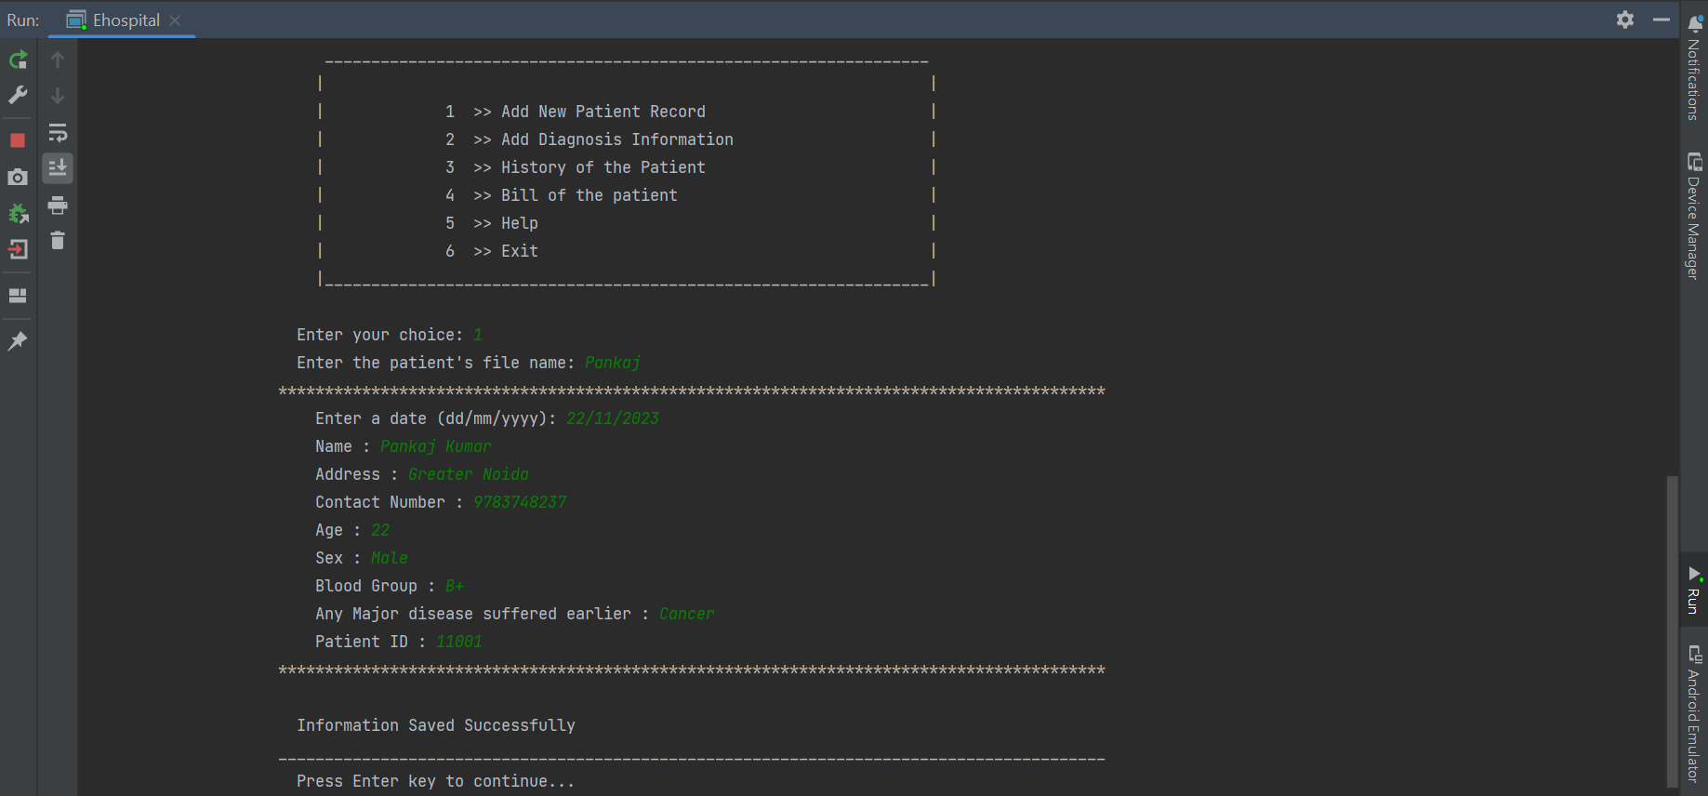

Slide 16
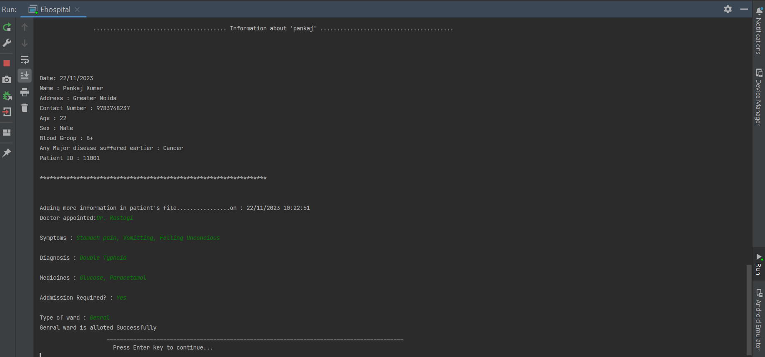

Slide 17
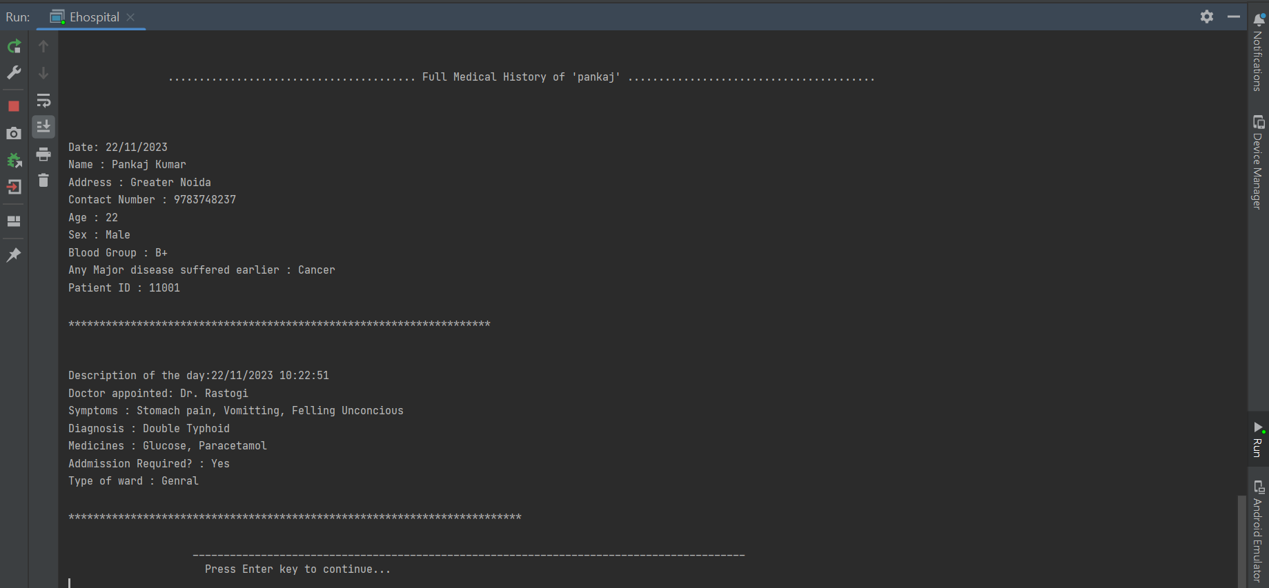

Slide 18
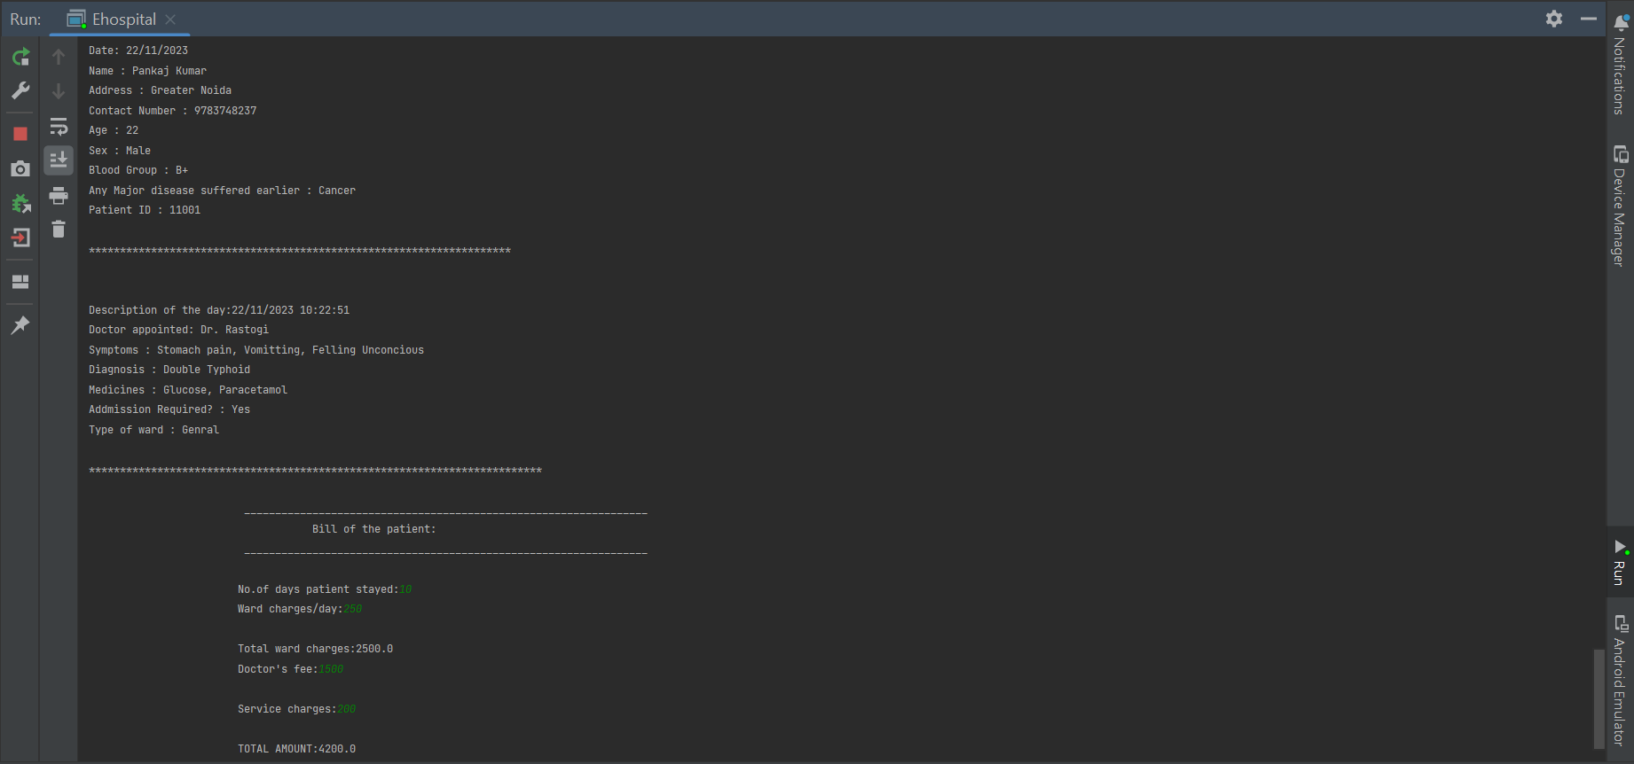

Slide 19
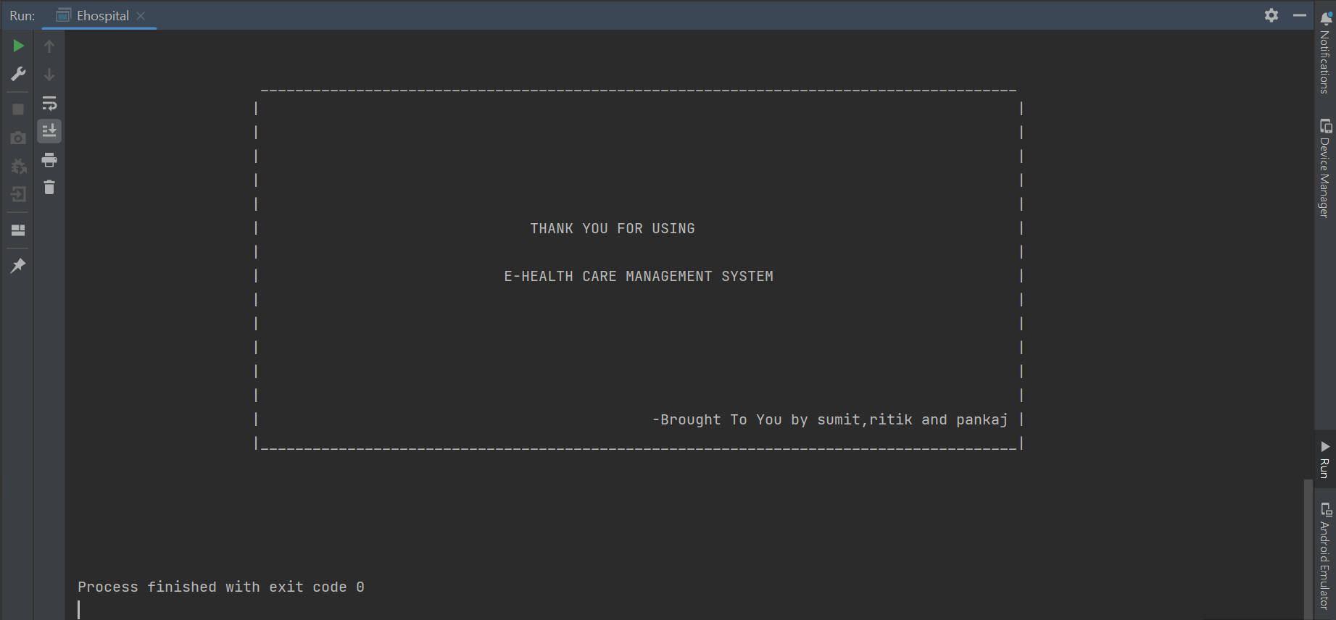

Slide 20
User requirements keep changing as the system is being used.
As the technology emerges, it is possible to upgrade the system and can be adaptable to desired environment.
Based on the future security issues can be improved using emerging technologies.
Modules can be added as per user requirement.
FUTURE ENHANCEMENT

Slide 21

CONCLUSION:
The project E health care management system is for computerizing the working in Hospital.
It provides a friendly graphical user interface which proves to be better when compared to the existing system.
Automation of entire system improves the efficiency.
Portable and flexible for future enhancement.
Updating of information becomes so easier.

Slide 22


